Slide 1
ANN | RNN
Fixed input | Variable input
Input sequence does not matter | Input sequence matters to hold context
No memory feature | Remembers the past inputs
Feed forward network | Feed Forward and Feed-back network

Slide 2
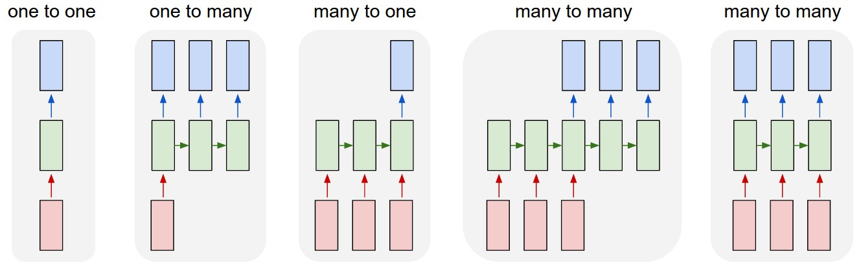

Slide 3
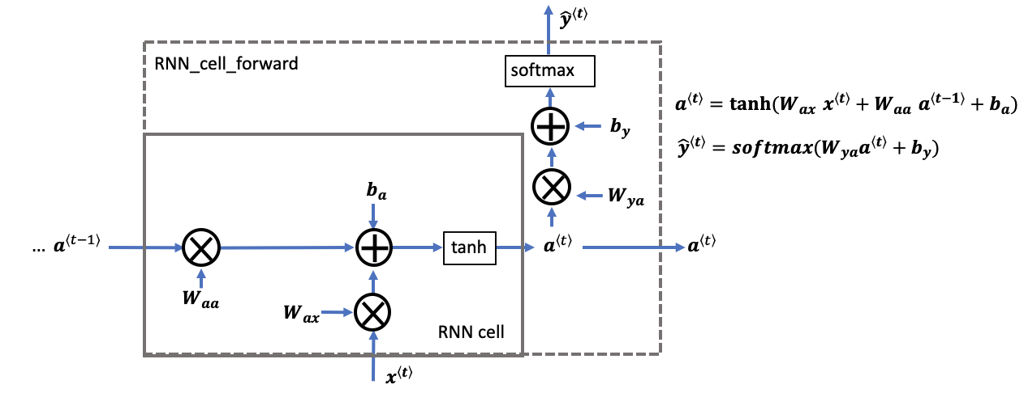

Slide 4
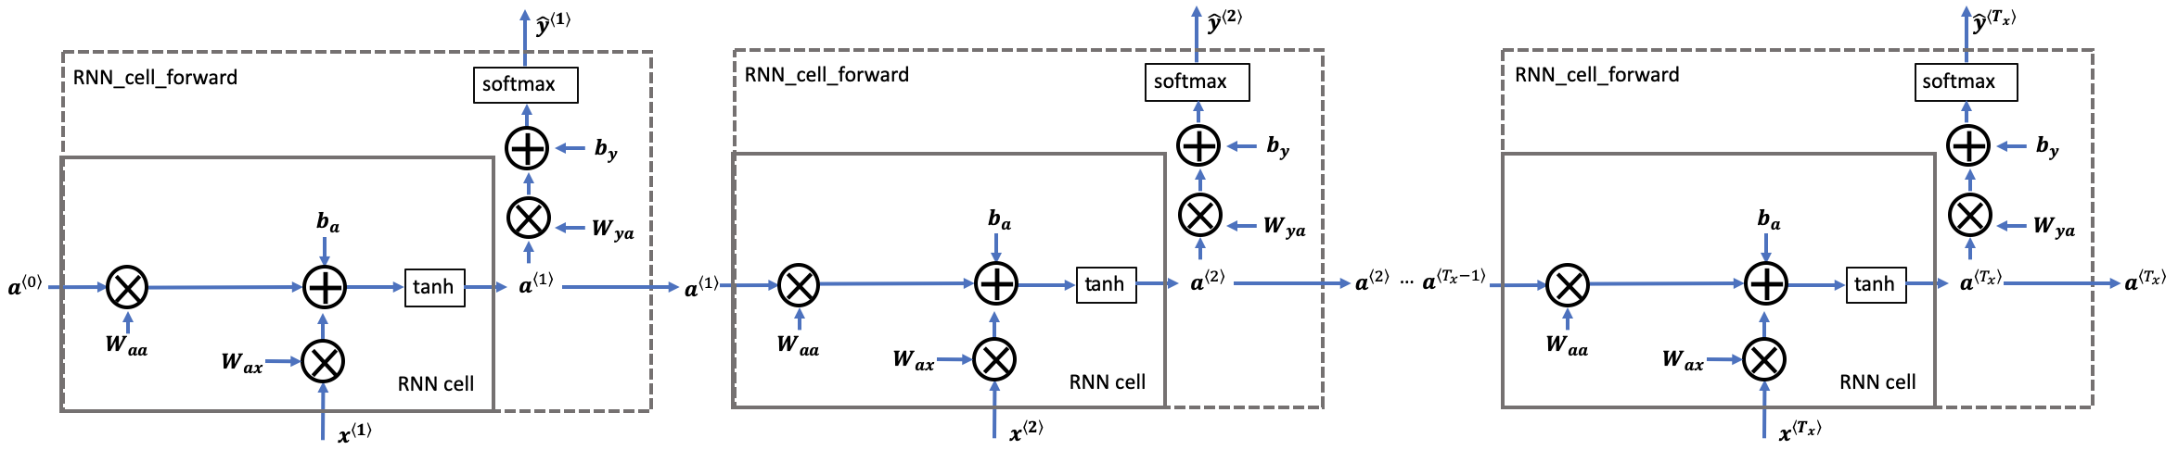
Forward Propagation: Unfolding through time

Slide 5
Word | OHE Vector (8 words in vocab) | Input features (x^{t}) | Time Stamp (t)
The | [1 0 0 0 0 0 0 0] | x^{<0>} | t0
dog | [0 1 0 0 0 0 0 0] | x^{<1>} | t1
chewed | [0 0 1 0 0 0 0 0] | x^{<2>} | t2
on | [0 0 0 1 0 0 0 0] | x^{<3>} | t3
a | [0 0 0 0 1 0 0 0] | x^{<4>} | t4
bone | [0 0 0 0 0 1 0 0] | x^{<5>} | t5
barked | [0 0 0 0 0 0 1 0] | x^{<6>} | t6
loudly | [0 0 0 0 0 0 0 1] | x^{<7>} | t7
Document:
X_{1:} The dog chewed on a bone
X_{2:} The dog barked loudly
Vector representation:
'The dog chewed on a bone’: [[1 0 0 0 0 0 0 0], [0 1 0 0 0 0 0 0], [0 0 1 0 0 0 0 0],
[0 0 0 1 0 0 0 0], [0 0 0 0 1 0 0 0], [0 0 0 0 0 1 0 0]]
‘The dog barked loudly’: [[1 0 0 0 0 0 0 0], [0 1 0 0 0 0 0 0], [0 0 0 0 0 0 1 0], [0 0 0 0 0 0 0 1]]

Slide 6
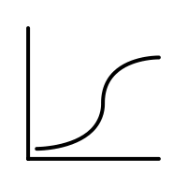

X_{1:} The dog chewed on a bone: [[1 0 0 0 0 0 0 0], [0 1 0 0 0 0 0 0], [0 0 1 0 0 0 0 0],
[0 0 0 1 0 0 0 0], [0 0 0 0 1 0 0 0], [0 0 0 0 0 1 0 0]]
The
ŷ^{<0>}
ŷ^{<1>}
bone
1
a^{<1>}
0
w_{aa = 5x5}
w_{aa}
b_{a = 5}
b_{a}
a^{<5>}
0
w_{ax = 8x5}
a^{<4>}
0
ŷ^{<5>}
0
0
0
0
a^{<0>}
= [0 0 0 0 0 0 0 0]
w_{ax}
w_{ax}
x^{<0>}
x^{<1>}
= [0 1 0 0 0 0 0 0]
x^{<5>}
= [0 0 0 0 0 1 0 0]
b_{y = 1}
w_{ax}
w_{ya = 5x1}
Fully connected
Network Recurrence is 6 times
RNN Arch.ipynb
Parameters = 40 + 5 + 25 + 5 + 1 = 76

Slide 7
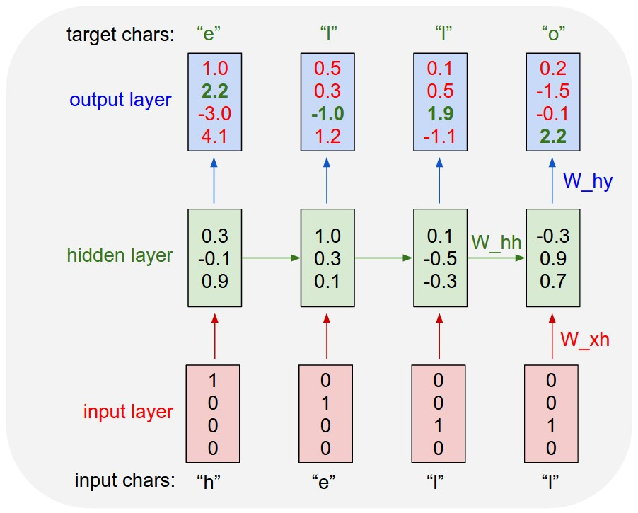

Slide 8
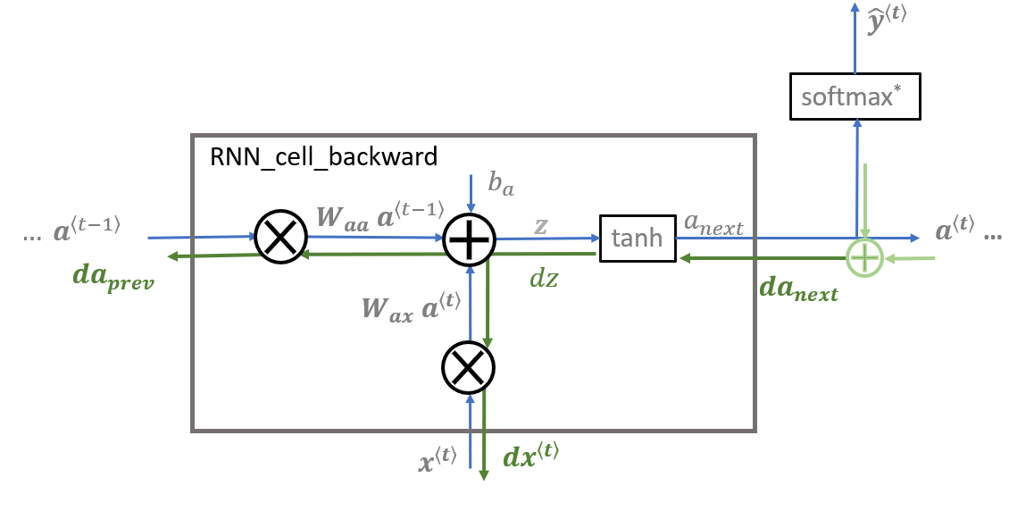

Slide 9
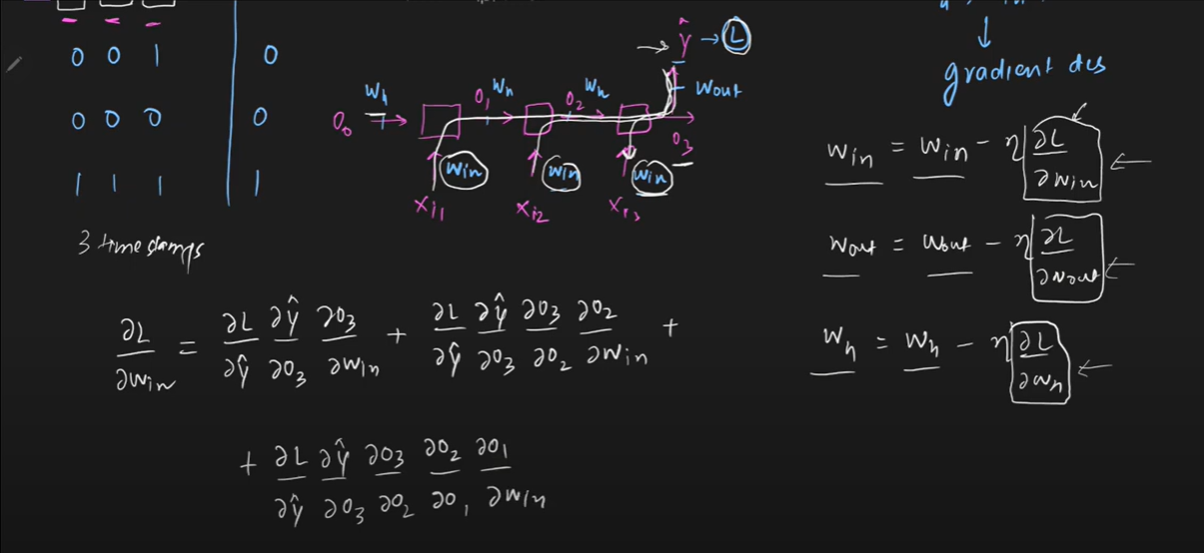
Exploding and Vanishing Gradients

Slide 10
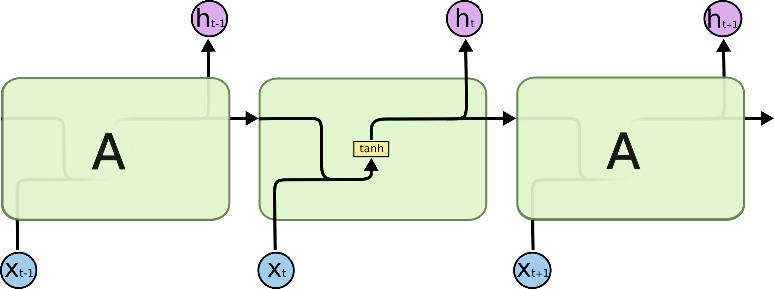

Standard RNN contains a single layer
An LSTM contains four interacting layers

Slide 11
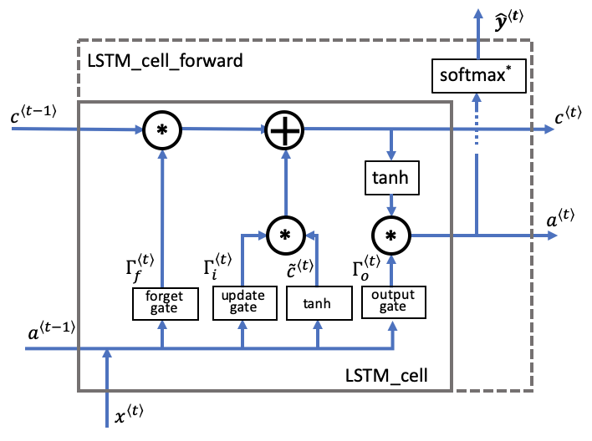
Forget Gate: Removes selective information from LTM
Input Gate: Adds selective information to LTM
Output Gate: Calculate hidden state and create STM
Cell State
LTM <t-1>
LSTM enables interactions between LTM and STM
Create STM
Hidden state STM <t-1>
Update LTM
Input <t>

Slide 12
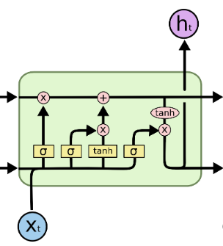
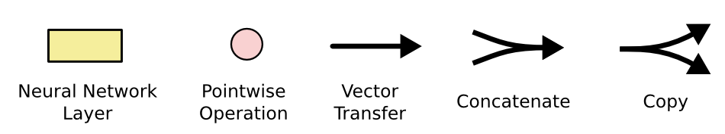
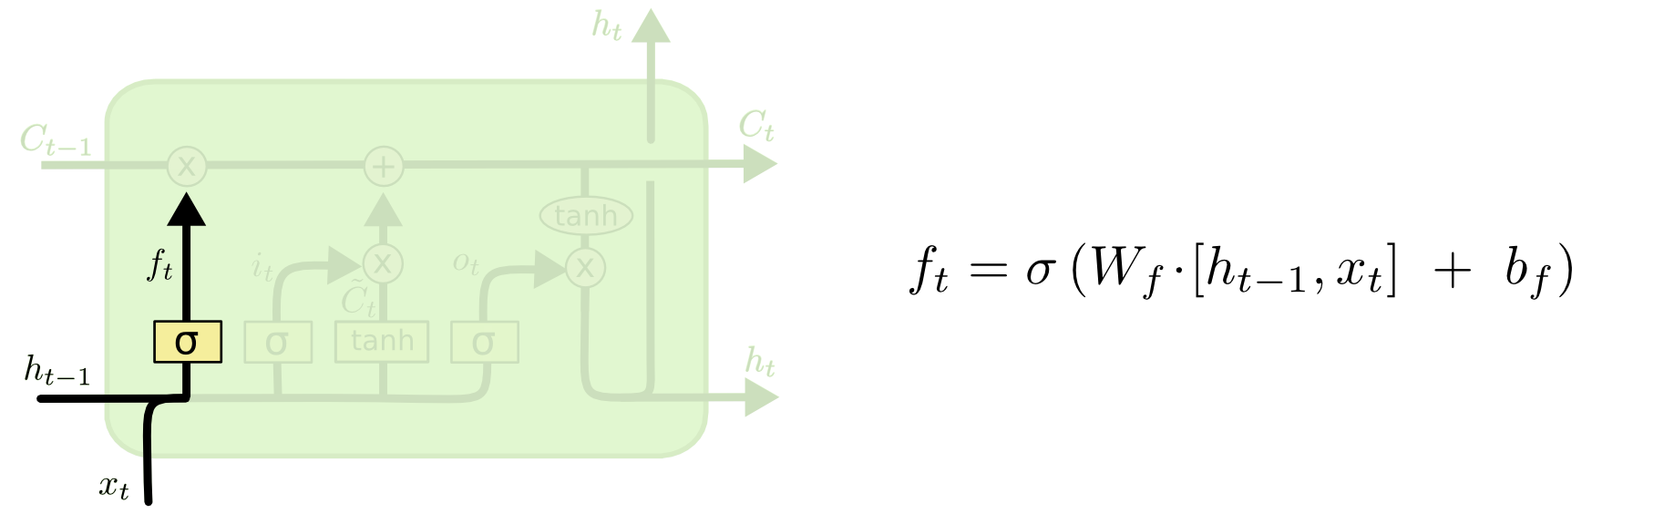
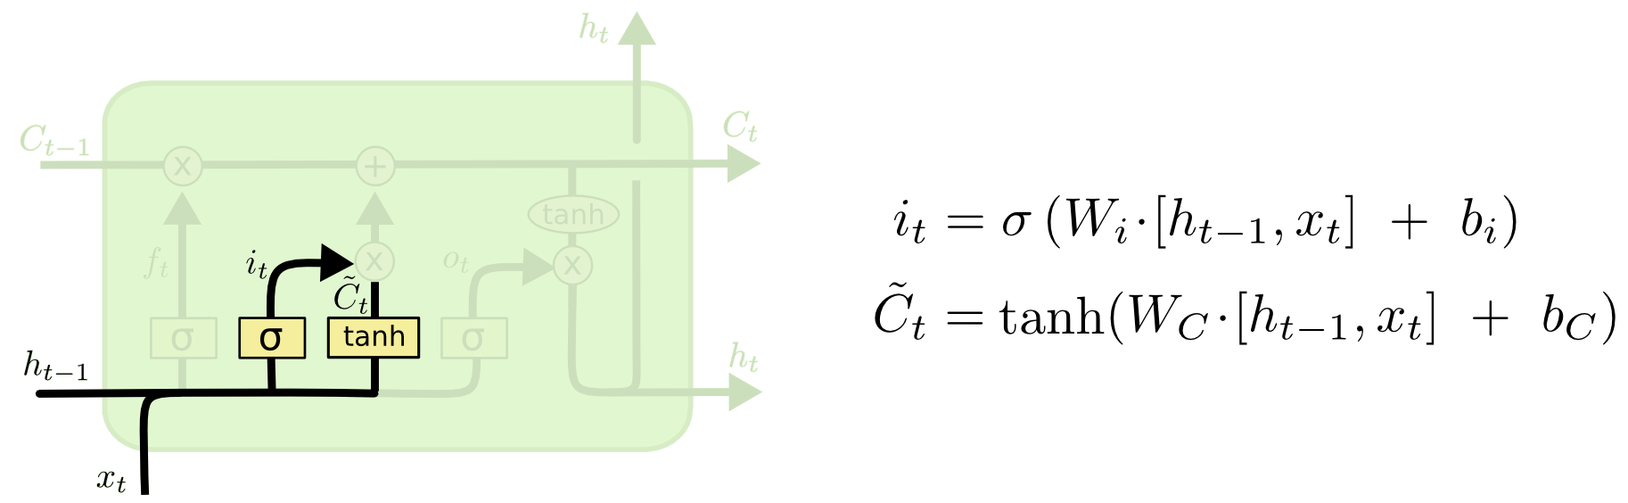
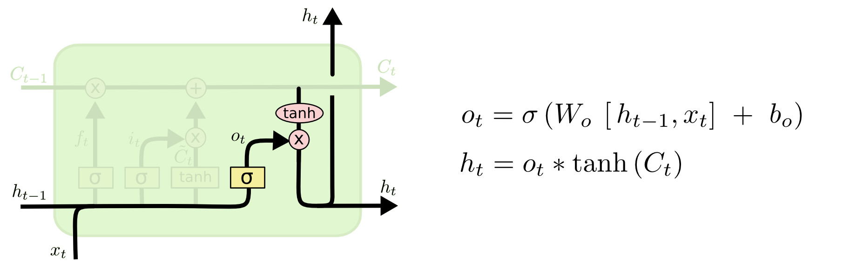
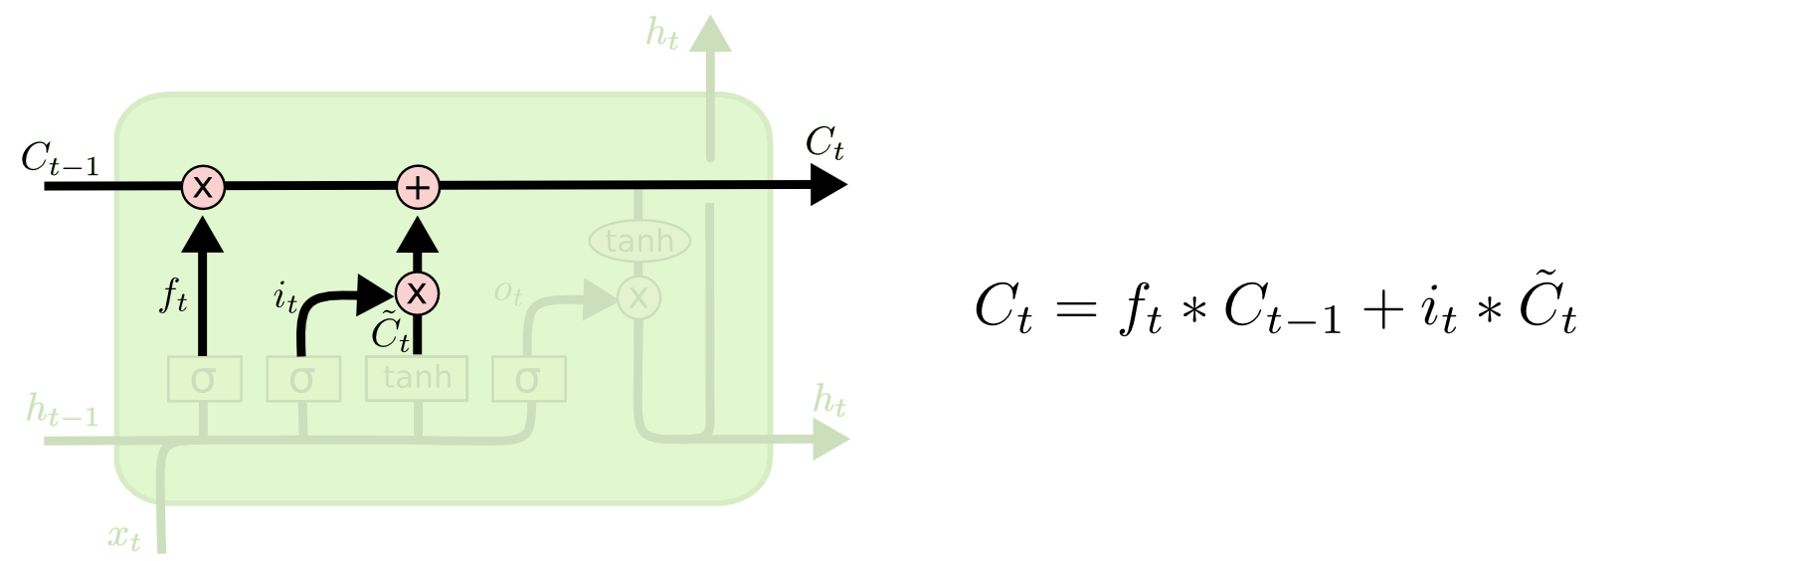
Step-by-Step LSTM
Walk Through
Forget Gate: Removes selective information from LTM
Input Gate: Adds selective information to LTM
Remember
NN Layer have same number of nodes
# of nodes is a hyper parameter
Dimensions of C̄_{t}, h_{t,} C_{t,} f_{t,} i_{t,} o_{t} are same
x_{t} dimension has no relation with C_{t} or h_{t}
Output Gate: Calculate hidden state and create STM
https://colah.github.io/posts/2015-08-Understanding-LSTMs/

Slide 13
Forget Gate: Removes selective information from LTM

Slide 14
Input Gate: Adds selective information to LTM
Filter
Potential information to LTM

Slide 15
New cell state

Slide 16
Output Gate: Calculate hidden state and create STM

